Slide 1

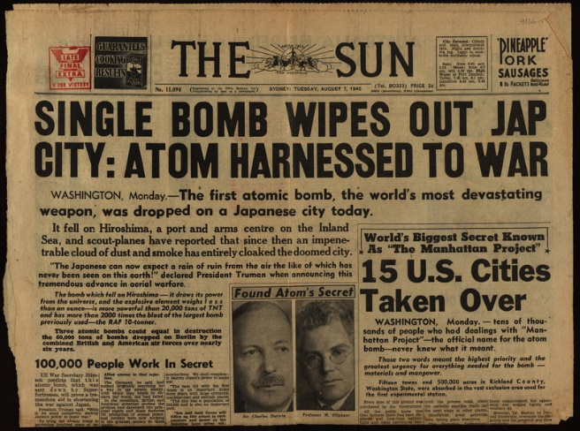
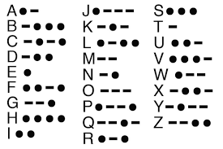
Optional Task 1
Write a newspaper report of a bombing on a street in London. Consider the features required to write a good newspaper report. Type of handwrite it.
Optional Task 2
Research Morse code. What was it? How was it used? Who invented it? Write your name using Morse code. Can write a message in Morse code?

