Slide 1
Welcome to Year 6!
Curriculum Information

Slide 2
Staff
Mrs Newton: Monday – Wednesday
Mr E: Thursday – Friday
Mrs Marriage: Monday – Thursday AM
(Mrs Roebuck: PPA cover Wednesday PM)

Slide 3
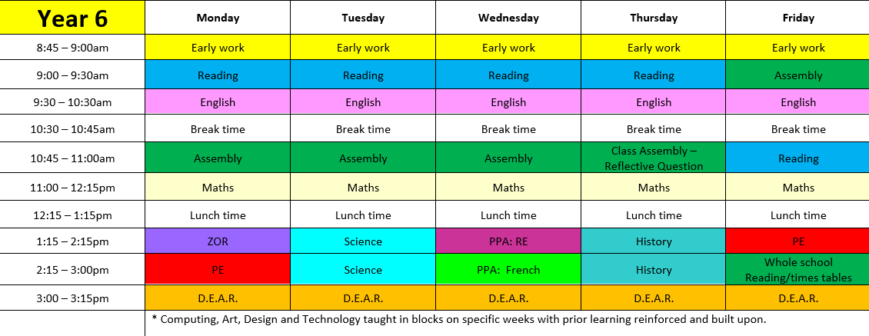
Curriculum

Slide 4

The Stocks Green Way
Our whole school community follows three rules:
Be Ready
Be Respectful
Be Safe

Slide 5

Our School Values
We try to instil these values in our whole school community.
At Stocks Green we are:
Kind
Respectful
Honest
Resilient
Inclusive

Slide 6

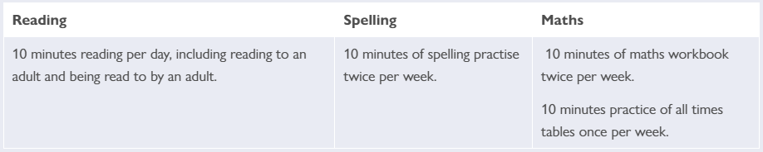
Homework
Our school has recently reviewed its homework policy. The home work expectations for our year group are…

Slide 7
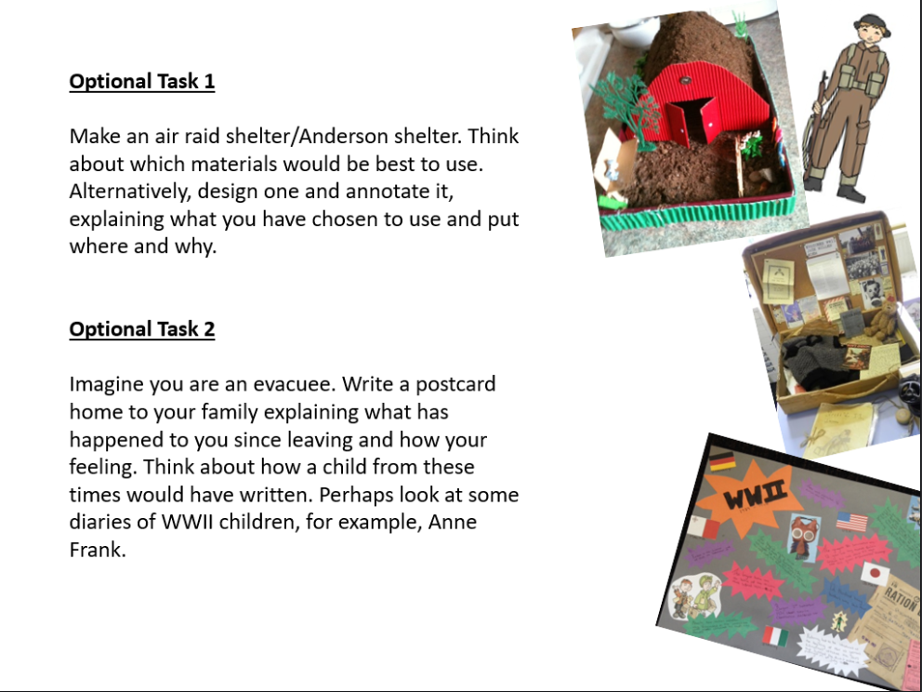
Homework
Inspiration Tasks!

Slide 8
Suggested ways to learn your spellings/phonics
Games with family and friends using the words and then spelling them (charades, hangman, boggle, scrabble)
‘Look, say, cover, write, check’
Chunking words into syllables
Understanding of root words, prefixes and suffixes
Mnemonics
Crosswords and wordsearches
Daily practice and overlearning

Slide 9
Suggested ways to learn your times tables
Short, daily, repetitive practice!
Tricks and patterns
Games (written and computer-based)
Flashcards
Quick quizzes

Slide 10
Communication
As a school we will always look to resolve any issues for you. As such, we would suggest that the best way to address any concerns is to speak to us on the classroom door so we can resolve them as quickly as possible.
However, as a school, we do appreciate this might not always be possible. So, our class email address is class6@stocks-green.kent.sch.uk
Please bear in mind that w e will only be checking and answering emails in work hours between 7:30am and 5:00pm and at busy times it may take up to 48 hours to respond. If your enquiry is more urgent that this, please contact the school office.

Slide 11
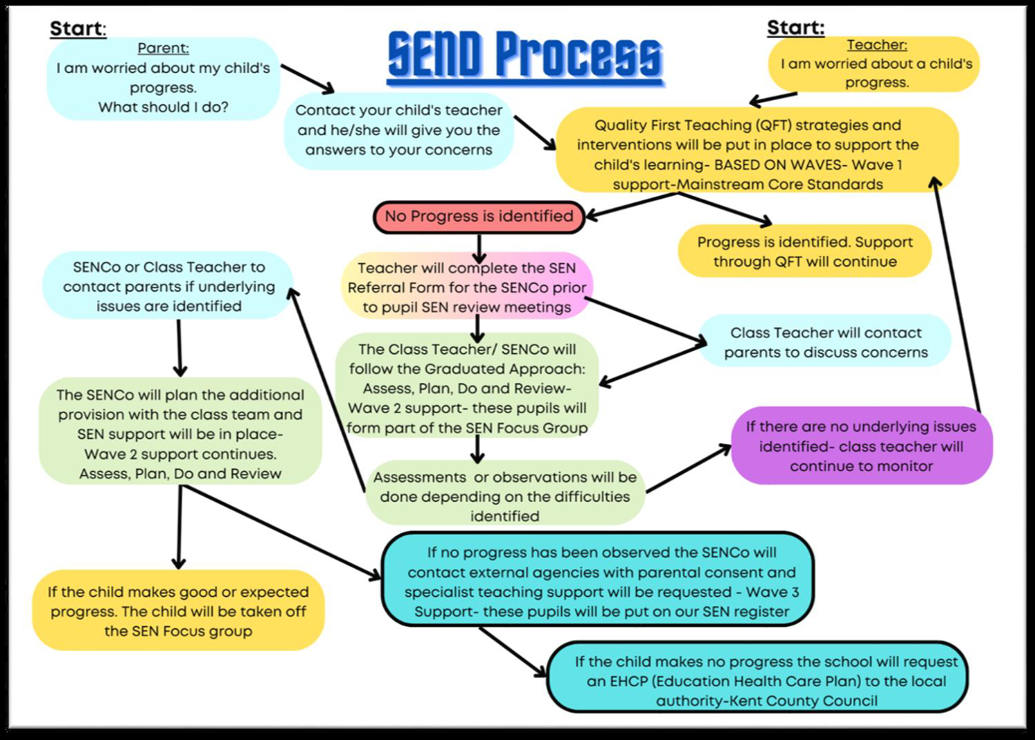
Concerns about your child’s progress

Slide 12
Support with the cost of living and additional funds for the school.
In school, children in Year R, 1 and 2 receive Universal Infant Free School Meals. However, if you are in receipt of certain benefits, you can also receive a free school meal in Years 3 - 6. To check your eligibility and register for this, you would need to search ‘Kent Free School Meals’ or go to:
https://www.kent.gov.uk/education-and-children/schools/free-school-meals
There is a double benefit to this, as the school will also receive an additional £1480 per pupil to support their learning and the teaching and learning across the school.
Even if your child is in Years R, 1 or 2 and already receives a free school meal, signing up can support their learning by accessing the additional funding.

Slide 13

Notes:
Please note further information about this will be coming out to parents in the next few weeks once all trips and events have been booked.

