Slide 1

The Stocks Green Way
Our whole school community follows three rules:
Be Ready
Be Respectful
Be Safe

Slide 2

Our School Values
We try to instil these values in our whole school community.
At Stocks Green we are:
Kind
Respectful
Honest
Resilient
Inclusive

Slide 3
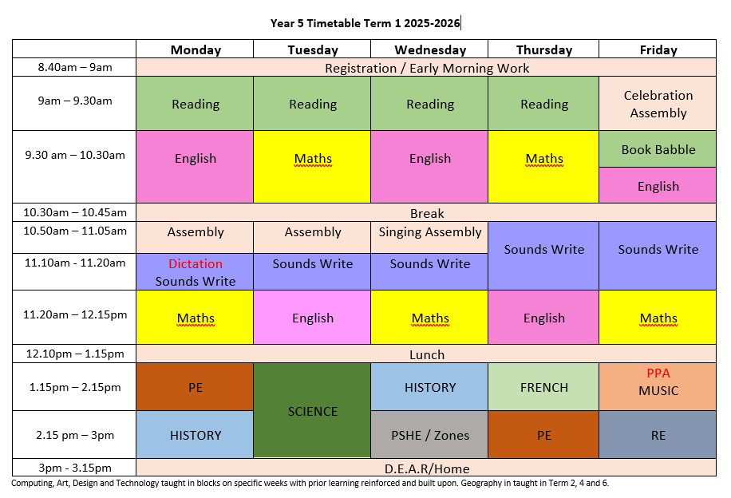

Slide 4
Reading
As with all year groups, reading will continue to be the corner stone of your child’s learning in Year 5. Reading with an adult and to an adult at home is extremely important so the children can practice strategies learnt during lesson time.
Year 5 will have a daily reading lesson, with a mixture of paired, choral and 1:1 reading.
Children will have a weekly Book Babble, where we will discuss book choice, share books and talk about favourites. This is a relaxed session rather than a “show and tell” and I will let the children know when it is their House’s turn.

Slide 5
Suggested ways to learn your spellings:
Look, Cover, Write
Rainbow Writing / Bubble Writing
Word Jumble games
Silly Sentences
Scavenger Hunt

Slide 6
Suggested ways to learn your times tables
As times tables play such an important role in the increasingly complex maths calculations your child will encounter in Year 5, it is very important that your child still practises them regularly. Those children who know their times tables should now continue to work on consolidation and working at speed.
Continue working online using TTRS, Hit the Button and Purple Mash
Flashcards
Repetition chanting – try doing this to a beat to create a rap.
Make up rhymes
Games such as speed challenges – Can you beat your score in 1 minute?
Focus on the trickiest ones – often 6, 7, 8 and 12
Use multiplication grids.

Slide 7
PE
This term PE will be on a Monday and a Thursday.
PE kit should be worn on these days.

Slide 8

Homework
Our school has recently reviewed its homework policy.
Expectations for Year 5
10 minutes reading per day, including reading to an adult and being read to by an adult. | 10 minutes of spelling practise twice per week | 10 minutes of maths workbook twice per week. 10 minutes practise of all times tables once per week.

Slide 9
Communication
As a school we will always look to resolve any issues for you. As such, we would suggest that the best way to address any concerns is to speak to us on the classroom door so we can resolve them as quickly as possible.
However, as a school, we do appreciate this might not always be possible. So, our class email address is:
class5@stocks-green.kent.sch.uk
Please bear in mind that w e will only be checking and answering emails in work hours between 7:30am and 5:00pm and at busy times it may take up to 48 hours to respond. If your enquiry is more urgent that this, please contact the school office.

Slide 10
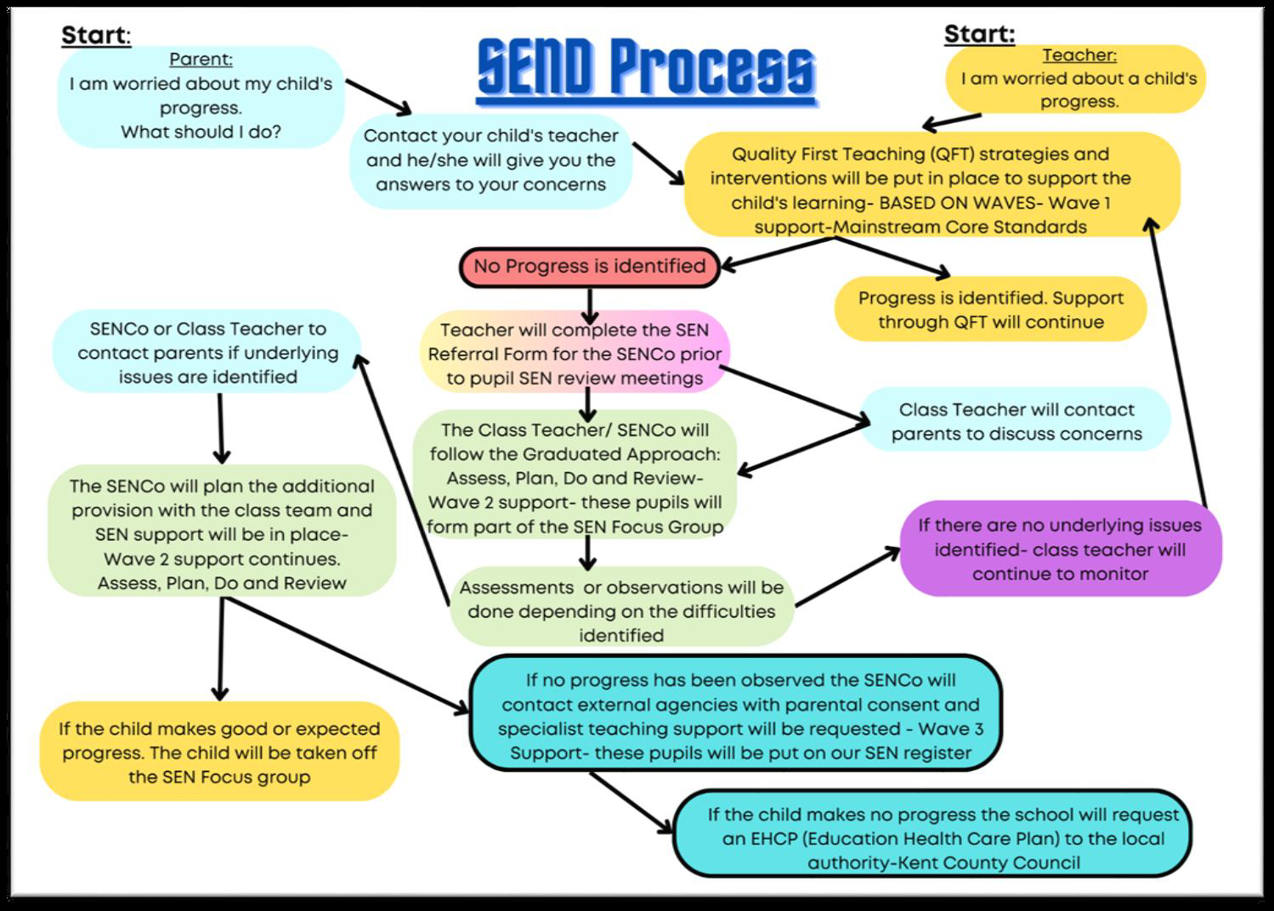
Concerns about your child’s progress

Slide 11
Support with the cost of living and additional funds for the school.
In school, children in Year R, 1 and 2 receive Universal Infant Free School Meals. However, if you are in receipt of certain benefits, you can also receive a free school meal in Years 3 - 6. To check your eligibility and register for this, you would need to search ‘Kent Free School Meals’ or go to:
https://www.kent.gov.uk/education-and-children/schools/free-school-meals
There is a double benefit to this, as the school will also receive an additional £1480 per pupil to support their learning and the teaching and learning across the school.
Even if your child is in Years R, 1 or 2 and already receives a free school meal, signing up can support their learning by accessing the additional funding.

Slide 12

Notes:
Please note further information about this will be coming out to parents in the next few weeks once all trips and events have been booked.

