Slide 1
Welcome to Year 3!
Parents Information Meeting
Tuesday 9th September 2025

Slide 2

Our School Rules
Our whole school community follows three rules:
Be Ready
Be Respectful
Be Safe

Slide 3
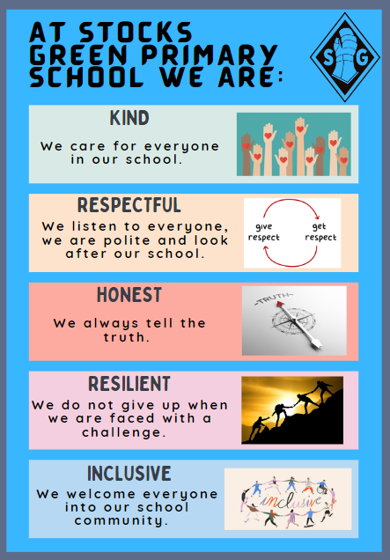
Our School Values
We try to instil these values in our whole school community.
At Stocks Green we are:
Kind
Respectful
Honest
Resilient
Inclusive

Slide 4
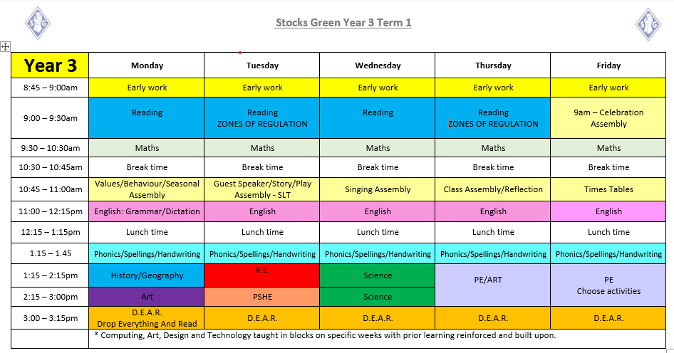

Slide 5
PE
Please can children come to school dressed in their PE kit on Thursdays and Fridays - P.E day this term. Children 's long hair should be tied back at all the times. If your child cannot participate in PE for any reason, please send a written note on the day.
Snack
In KS2 th children are not provided with a healthy snack every day. Please provide for your child/children a healthy snack, e.g. a piece of fruit or vegetables.
Water Bottles
Please provide water only in your child’s water bottle.

Slide 6
Learning/Groups
Most learning in English and Maths will consist of whole class teaching, followed by independent or group tasks with children generally grouped with those of a similar ability, however some mixed ability groupings will be used when we feel it is appropriate.
The children will have talk partners to enable them to share their thoughts and ideas. We will aim to change talk partners every term to encourage your children to make new friends, support one another and develop their social communication skills.

Slide 7

Notes:
Please note further information about this will be coming out to parents in the next few weeks once all trips and events have been booked.

Slide 8

Homework
The homework expectations for our year group are:
In addition to the weekly homework tasks already mentioned we will also be setting OPTIONAL termly homework projects in order to inspire your children to extend their learning beyond the classroom.
Each term two optional tasks, related to the current learning in history, geography or science, will be published on our class page on the school website for pupils who wish to explore them.
We would love to see any completed tasks in school or via email.

Slide 9
Suggested ways to learn your spellings/phonics
Look, cover, write, check
Phonics/spelling games
https://superbrainybeans.com/english/spelling/year-3/
https://www.bbc.co.uk/bitesize/topics/zw68h4j
Other techniques:
https://doodlelearning.com/english/subjects/spelling/spelling-strategies-for-ks2

Slide 10
Suggested ways to learn your times tables
Times table rockstars
https://www.timestables.co.uk/
times table songs e.g. https://www.youtube.com/watch?v=e7rYbk9PNuM&list=PLaCFIecv0Ivcv38rCq1JX_eNjymz7Pj-u&index=7
Use a multiplication chart: https://suncatcherstudio.com/printables/math/multiplication-charts/

Slide 11

Reading
Over the next one or two weeks I will be reading with all children 1:1. Once this is completed, your child will be sent home with reading book/s with a reading record. Please listen to your child read and record and sign when/how much they have read each week ☺ Please can children bring their reading record to school every day so we can monitor their progress.
We will be having our class reading session everyday, to help the children develop all their reading skills, such as fluency, expression and comprehension. Every child will be heard reading weekly.

Slide 12
Communication
As a school we will always look to resolve any issues for you. As such, we would suggest that the best way to address any concerns is to speak to us on the classroom door so we can resolve them as quickly as possible.
However, as a school, we do appreciate this might not always be possible. So, our class email address is:
class3@stocks-green.kent.sch.uk
Please bear in mind that we will only be checking and answering emails in work hours between 7:30am and 5:00pm and at busy times it may take up to 48 hours to respond. If your enquiry is more urgent that this, please contact the school office.

Slide 13
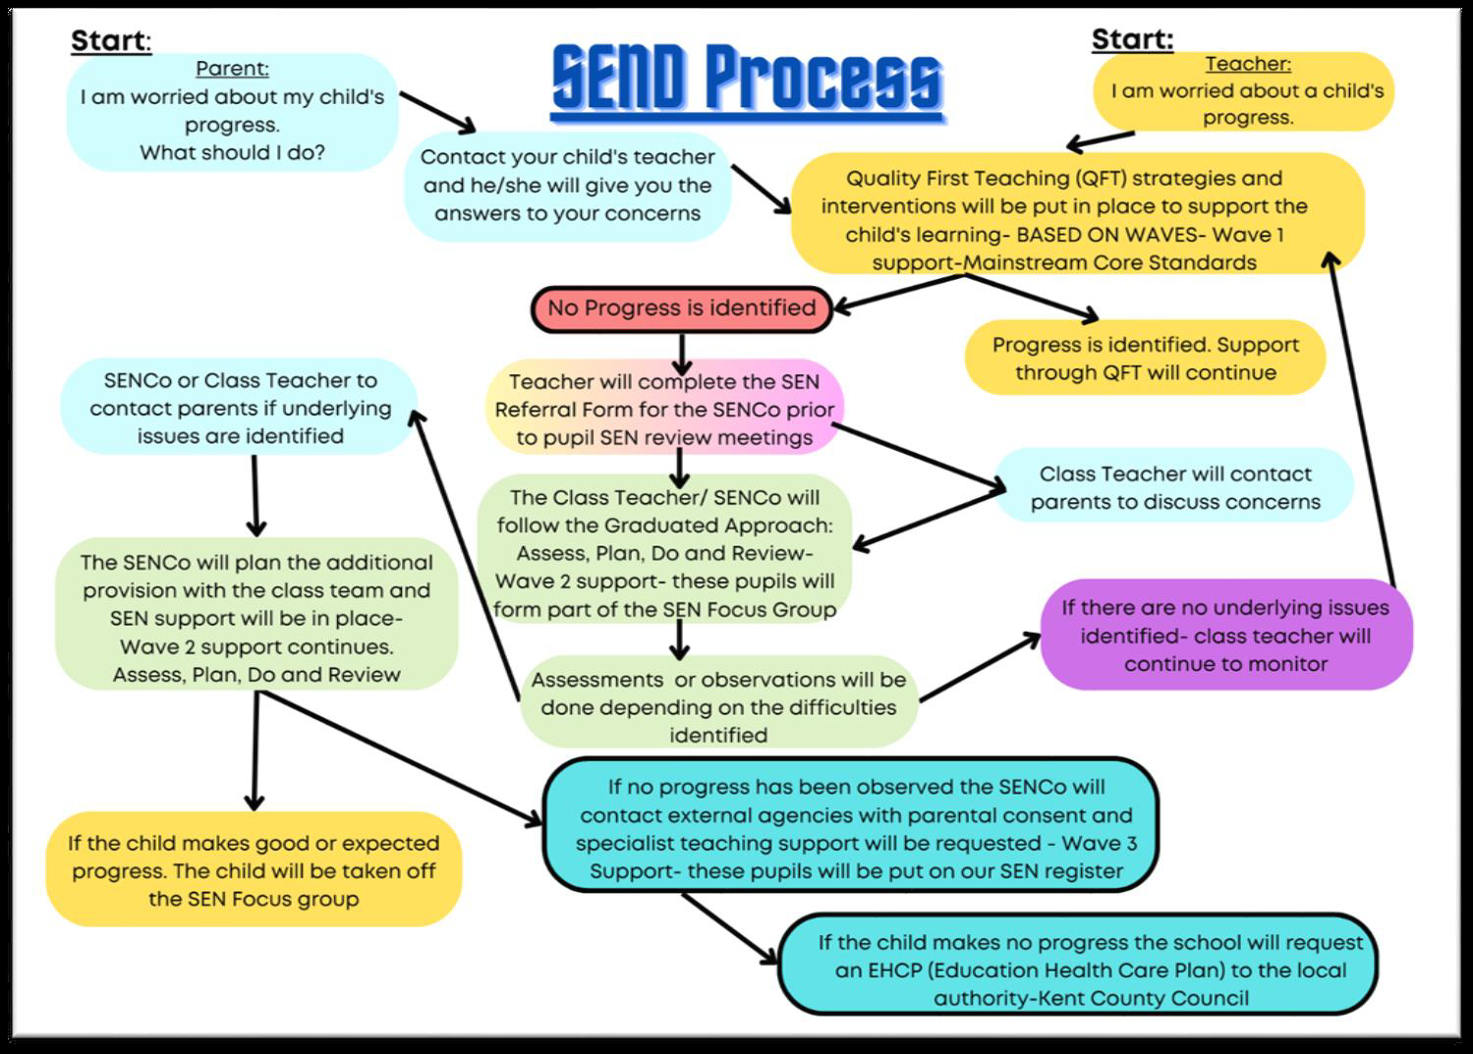
Concerns about your child’s progress

Slide 14
Support with the cost of living and additional funds for the school.
In school, children in Year R, 1 and 2 receive Universal Infant Free School Meals. However, if you are in receipt of certain benefits, you can also receive a free school meal in Years 3 - 6. To check your eligibility and register for this, you would need to search ‘Kent Free School Meals’ or go to:
https://www.kent.gov.uk/education-and-children/schools/free-school-meals
There is a double benefit to this, as the school will also receive an additional £1480 per pupil to support their learning and the teaching and learning across the school.
Even if your child is in Years R, 1 or 2 and already receives a free school meal, signing up can support their learning by accessing the additional funding.

Slide 15
Our class email: class3@stocks-green.kent.sch.uk
We are looking forward to a busy and exciting year and look forward to working with you.

