Slide 1
Year 1 Curriculum Information 2025-2026

Slide 2
Year 1 Staff
Class Teacher:
Miss Dargie
Teaching Assistants:
Mrs Faingold (Every morning).
Mrs Aarons (Monday, Tuesday and Wednesday afternoons).
Mrs Hancock (Friday afternoons to cover PPA time).

Slide 3

Our School Rules
Our whole school community follows three rules:
Be Ready
Be Respectful
Be Safe

Slide 4

Our School Values
We try to instil these values in our whole school community.
At Stocks Green we are:
Kind
Respectful
Honest
Resilient
Inclusive

Slide 5
The Year 1 curriculum builds upon and extends the experiences that children have had in Reception.
English and Mathematics will be taught every day.
Phonics will be taught for 2 x 30 minutes every day to support with reading, writing, and spelling.
The children will follow the rest of the Key Stage One National Curriculum subjects which will be taught throughout the week.
The children will learn through a range of class, group, paired and individual activities.

Slide 6
The children have now completed the Early Years Foundation Stage.
They are now in Key Stage One.
The children will now study the National Curriculum subjects. These are:
Mathematics Physical Education (PE)
English Design and Technology
Science Music
Geography Computing
History Personal, Social and Health Education
Art and Design Religious Education (RE)

Slide 7

The Year One Curriculum Overview can be found on our class page.

Slide 8
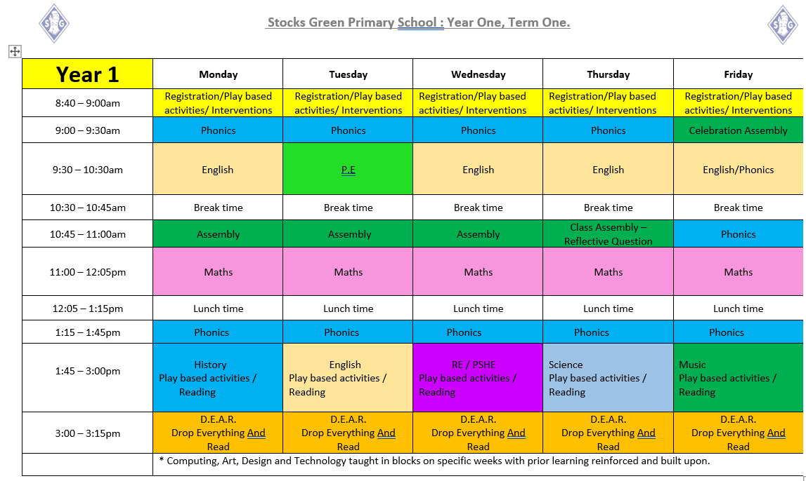
Timetable

Slide 9
Reading
Reading books will be sent home on a Monday.
The children will have two books a week from the Sounds Write/ Dandelion schemes.
Please sign or initial your child’s reading record so we know your child has read to you.
Please can the children bring their reading books to school every day.

Slide 10
Assessments in Year 1
Year 1 Phonics Screening Check
The check will take place in June 2026
Information about this will be given on our class page on the website. There will also be a meeting later on in the year to explain this.

Slide 11


Homework
Our school has recently reviewed its homework policy. Homework will be set on Mondays. The home work expectations for our year group are:

Slide 12
Suggested ways to learn your spellings/phonics:
Phonics:
Sounds-Write and Dandelion reading books
Websites: Phonics Play, Mr Thorne.
BBC iplayer: Alphablocks
Spellings: Look, Cover, write , check
Write spellings in felt pens, pencils, in sand etc

Slide 13
Suggested ways to learn to count in 2s, 5s and 10s:
Using cards with the numbers on them and putting them in the correct order.
Say the numbers when looking at the cards, Take some away and count, saying the missing numbers too.
Sorting objects into sets and counting them, so they have a clear understanding of the numbers, eg using lego pieces, counters, pieces of pasta etc
Writing the numbers on the ground, eg in mud, sand. Jump from each number and say the number as you jump.

Slide 14
Optional Inspiration Tasks:
Two of these will be set per term on our class web page, these will relate to our foundation subject learning in class.

Slide 15
What else do we do in Year 1?
Forest School
Outings : To Tonbridge Castle in the Spring Term and to Romshed Farm in the Summer Term.
Carol concert
Charity Days
Sports Day

Slide 16

Notes:
Please note further information about this will be coming out to parents in the next few weeks once all trips and events have been booked.

Slide 17
Communication
As a school we will always look to resolve any issues for you. As such, we would suggest that the best way to address any concerns is to speak to us on the classroom door so we can resolve them as quickly as possible.
However, as a school, we do appreciate this might not always be possible. So, our class email address is class1@stocks-green.kent.sch.uk
Please bear in mind that we will only be checking and answering emails in work hours between 7:30am and 5:00pm and at busy times it may take up to 48 hours to respond. If your enquiry is more urgent that this, please contact the school office.

Slide 18
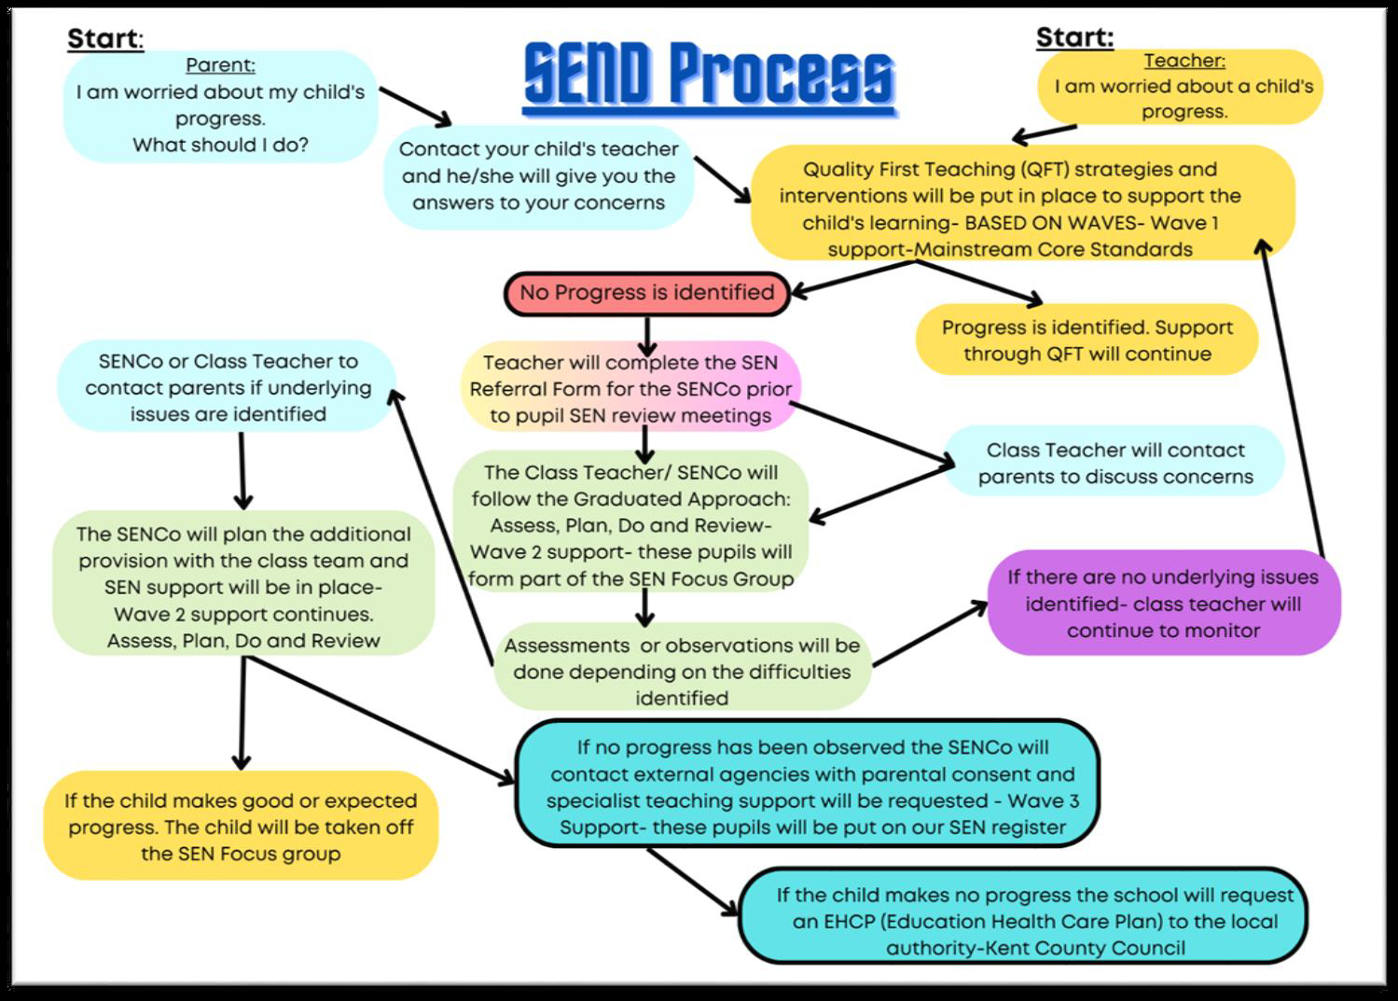
Concerns about your child’s progress

Slide 19
Support with the cost of living and additional funds for the school.
In school, children in Year R, 1 and 2 receive Universal Infant Free School Meals. However, if you are in receipt of certain benefits, you can also receive a free school meal in Years 3 - 6. To check your eligibility and register for this, you would need to search ‘Kent Free School Meals’ or go to:
https://www.kent.gov.uk/education-and-children/schools/free-school-meals
There is a double benefit to this, as the school will also receive an additional £1480 per pupil to support their learning and the teaching and learning across the school.
Even if your child is in Years R, 1 or 2 and already receives a free school meal, signing up can support their learning by accessing the additional funding.

Slide 20
Acceptable Use Policies
The school has updated its Acceptable Use of ICT policies to reflect the government’s latest guidance.
The new ICT and Acceptable Use Policy will be on the school website to view.
Parents will be soon be sent two Acceptable Use Policies (one for pupils and one for parents). Please can you discuss the Pupil Acceptable Use Policy with your child and then return it, signed by both the pupil and parent. Please can you also return the Parent Acceptable Use Policy at the same time.
Thank you for your support with this.

Slide 21
We are really looking forward to working with you this year, thank you.

