Slide 1

Treasurer’s Report for 2022/23

Slide 2






Profit and Loss from 01/09/22 – 30/08/23
Type | Total Generated | Revenue ↓ | Expenses
Xmas Activities | 4,000.05 | 5,997.32 | -1,997.27
Summer Fair / fun day | 4,562.25 | 5,868.64 | -1,306.39
Junior Disco/Infant party | 1,401.93 | 1,844.67 | -442.74
Cinema Nights | 519.9 | 717.7 | -197.8
2022-23 events | 272.16 | 498.69 | -226.53
Miscellaneous | 85.09 | 466.65 | -381.56
Cake Sale | 328.85 | 408.85 | -80
Second hand Uniform | 237.64 | 337.64 | -100
Easyfundraising/Amazon | 299.8 | 299.8 | 0
Present Fair | -259.73 | 0 | -259.73
Mini Marathon | 0 | 0 | 0
Xmas raffle | 0 | 0 | 0
Xmas Ball | 0 | 0 | 0
 | 11,447.94 | 16,439.96 | -4,992.02

Slide 3

School Contributions
Contribution | Cost
Reading Helper Support | £660.00
Class resources donation SG Invoice SG898 | £700.00
Robotics Equipment | £8140
Pond repairs | £1885
New notice board for Stock Green school | £325.00
Tree surgery | £150
Sports jumpers for entire school | £2,200.00
Y6 PHOTO BOOKS | £272.00
TOTAL: | 14,332.11

Slide 4
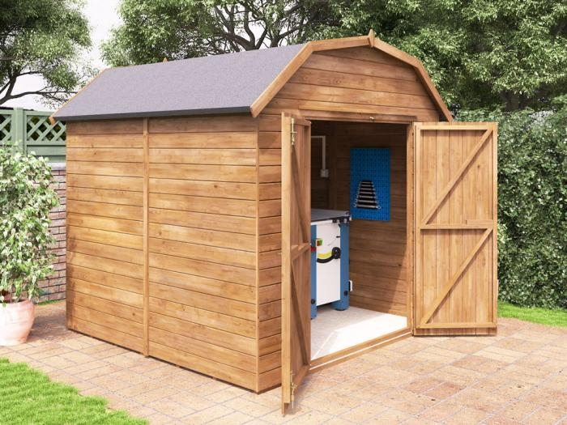
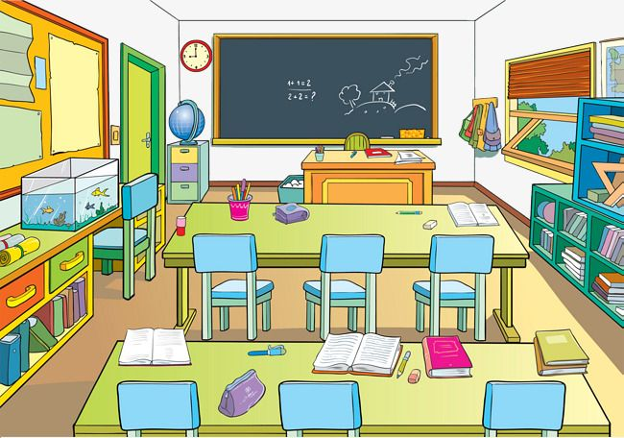

Balance from 01/09/22 – 30/08/23
Opening Balance | £15,621.04
Income | £16,439.96
Expenses | -£4,992.02
Expenditure | -£14,332.11
Closing Balances: | £12,736.87
Cash | £1.00
Current Account | £2,735.87
Savings Account | £10,013.00
£6079
£1200
£330

Slide 5
Year on Year
Event | 2022/23 | 2021/22 | 2020/21 | 2019/20
School Purchases | -14,332.11 | -2,863.60 | -2,795.41 | -11,389.84
Second hand Uniform | 237.64 | 603.06 | 559.86 | 121.50
EF/AMZ | 299.8 | 257.32 | 321.65 | 45.15
Cinema Nights | 519.9 | 469.25 | 531.98 | 252.33
Junior/Infant Disco | 1,401.93 | 0.00 | 0.00 | 627.85
Cake Sales | 328.85 | 628.57 | 0.00 | 291.01
Summer Fair | 4,562.25 | 3,143.25 | 0.00 | 0.00
Xmas Events | 4,000.05 | 1848.20 | 902.67 | 2,218.34
Sponsored Run | X | 2,039.00 | 2750.15 | 275.38
TOTAL ANNUAL P&L | £11,447.94 | £9,005.24 | £7,414.71 | -6,397.49

Slide 6


2022/23 Problems and Solutions
No online banking.
Paying everything with cheques.
Financial reporting very laborious.
PTA events were cash-only.

Slide 7
Targets for 2023/24
Passive income opportunities e.g., More grant applications, corporate donations etc.
Explore investments / interest on savings e.g., apportion PTA funds into 3-4% savings accounts.
Consolidate online applications e.g., JustGiving, PayPal, SumUp, Banking.

